Slide 1

the
workshop

Slide 2
PIE CHART ESSENTIAL LANGUAGE
Đơn vị: the proportion | percentage | rate of ….
e.g: (practice)
In 1995, the percentage of coal was/stood at 29.8% (percent).
***percentage vs percent
Chiếm: [type] account for + …% + of [the total]
take up/make up/occupy/constitute/represent
e.g: In 1995, coal made up 29.8% of the total / the total amount of energy produced / the total energy production [read the question & charts’ title].
***Phân số (thay cho %):
50% - ½: a half; 25% - ¼: a quarter
tử số: số (one, two, three) / mẫu số: số thứ tự (third, fourth, etc)
Practice: 1/3; 1/5; 2/3; 3/4; 5/6; 4/8
Notes:
Percent vs percentage: cái nào có số đằng trước? The … of

Slide 3
MORE NATURAL EXPRESSIONs
Spending
The defense department comprised 19,5% of the US government’s budget.
= The US government spent 19,5% of its budget on the defense department. (spend money on)
= 19,5% of the US government’s budget was spent on the defense department. (Passive)
Energy
Coal occupied 29.80% of all energy production in Scotland.
= Coal produced|generated|yielded 29.80% of all energy production in Scotland.
= 29.80% of all energy production in Scotland was generated by coal.
Reasons for migration
Looking for work accounted for 22% of the total reasons for migration to the UK
= Looking for work was the reason for 22% of all migration to the UK

Slide 4
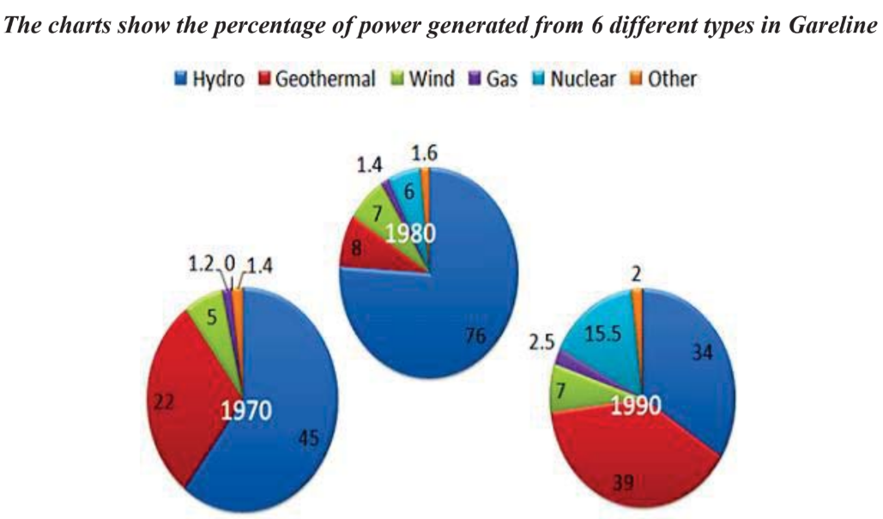
DYNAMIC PIE CHARTs - OVERVIEW
Overview: trend + order
Overall, nuclear power output increased significantly, while that of hydro and geothermal energy fluctuated over the time frame. In addition, geothermal power and hydro power were always the two most productive sources.
1.What tense should you use to describe these charts?
2.Can you describe the “increases” and “decreases”?
Notes:
Trend tăng làm thay đổi order -> nhóm theo trend

Slide 5
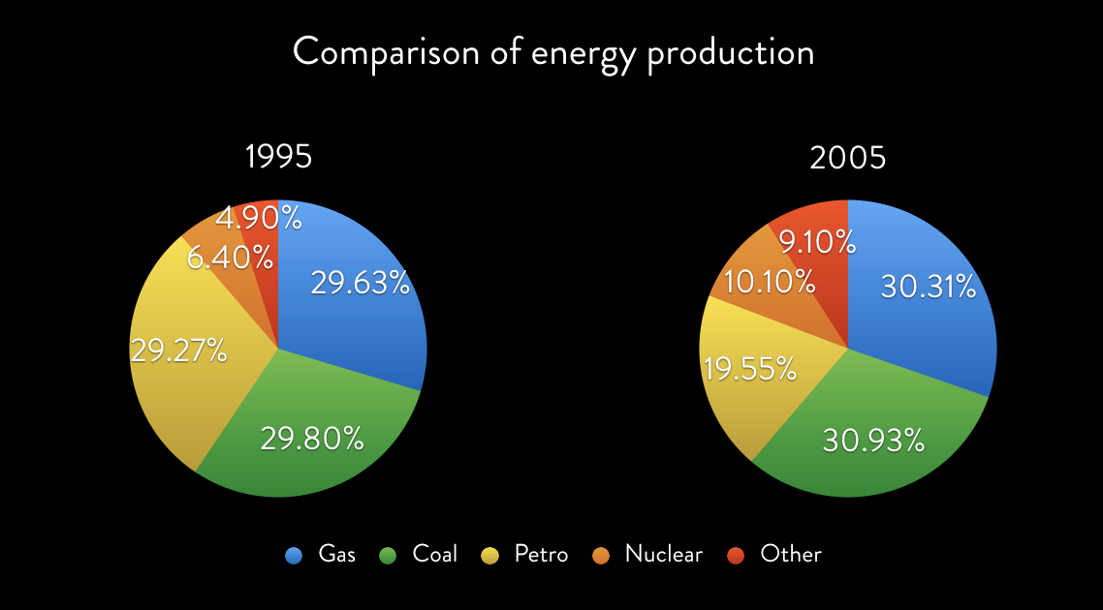
DYNAMIC – OVERVIEW OUTLINE
Câu 1: trend.
The percentage of petro decreased dramatically.
Those of others increased.
***1/2 loại khác so với trend chung => trường hợp đặc biệt
Except for/with the exception of …
Từ câu 2 : order.
Gas & Coal & Petro output - highest
Notes:
Cho viết – chữa

Slide 6
Câu 1: trend.
As can be seen from the graphs, with the exception of/except for the amount of energy produced by the petro industry, that made by all sources increased slightly over the timeframe, with nuclear and other power output going up at a greater extent/degree. (with + S + V_ing)
Từ câu 2: order
In addition, the majority of energy was produced using gas, coal and petro power.
Notes:
1 loại khác => except for/with the exception of; gộp vào & nói cụ thể ra (nếu cái slightly giống significantly về change)

Slide 7
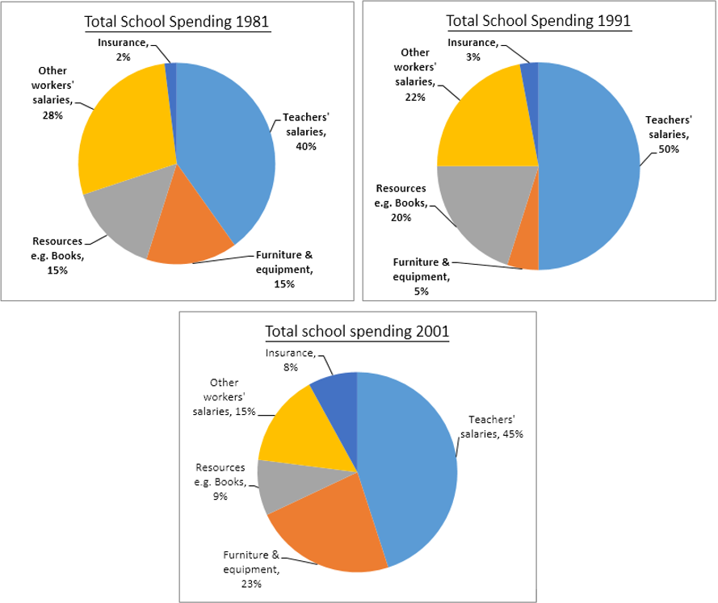
HOMEWORK
Write the introduction & overview for the task (handout).
Question:
“The three pie charts below show the changes in annual spending by a particular UK school in 1981, 1991 and 2001.”

